Slide 1
SQL
Aggregations

Slide 2
Why do we need multiple tables ?
Different types of objects.
It is possible that one table needs to update the records other than the primary key therefore that update will not shall not affect the other tables.
Orders & customers
A customer may have more than one orders, its easier to update the order table rather than updating a single table.
Moreover, a customer may change address that needs not to be added or updated in the orders table.
Speed of execution is better when each table has data related to itself.

Slide 3
3 ideas of db normalization
Are the tables storing logical groupings of the data?
Can I make changes in a single location, rather than in many tables for the same information?
Can I access and manipulate data quickly and efficiently?
Analysts don’t really have to work on normalization.
Notes:
https://www.itprotoday.com/sql-server/sql-design-why-you-need-database-normalization

Slide 4
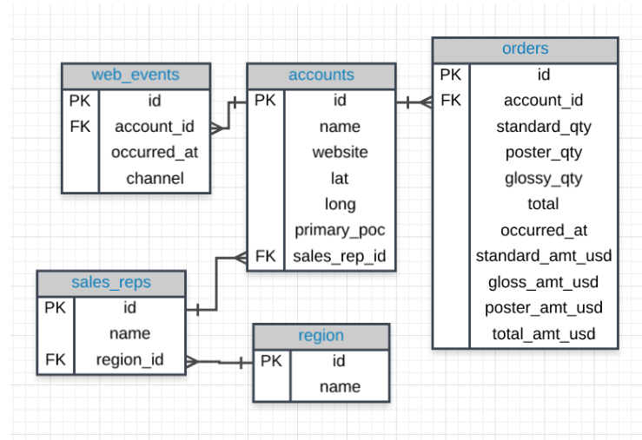
ER Diagram

Slide 5
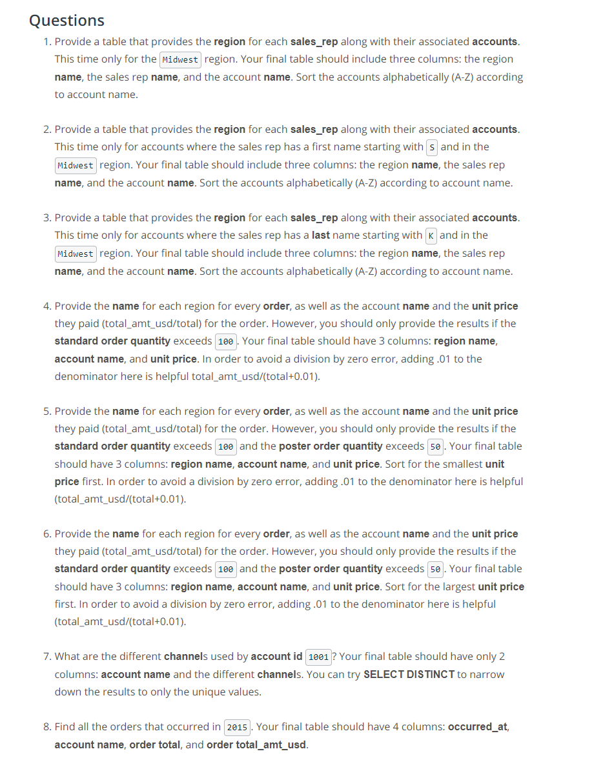
Notes:
Answers are in the notepad++ file.

Slide 6
Why do we need joins other than inner join ?
If we want to include the data which does not exists in both the tables.
Imagine a scenario when we have onboarded some new customers who have not yet placed any order. They will not occur in the order table.
Maybe we want information on the customers who have placed the order plus who have not yet placed the order.
Notes:
Full outer joins are very rare. https://stackoverflow.com/questions/2094793/when-is-a-good-situation-to-use-a-full-outer-join

Slide 7
Filtering in the on clause
Reduces the rows before combining the tables.
On the other hand, where clause logic occurs after the joining tables.
Filtering in on clause is faster as compared to where clause.

Slide 8
Advanced Joins
Union
Union All
Cross Join
Self Join

Slide 9
Group by check
Always see any columns in the select statement, that are not being aggregated on in the group by statement.

Slide 10
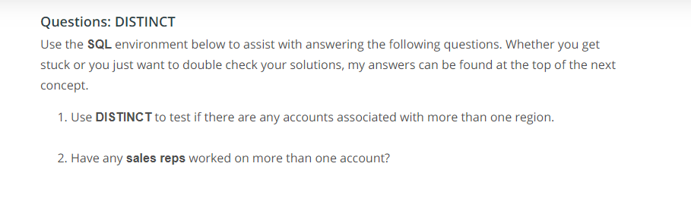
Questions
Notes:
I could not solve these questions.

Slide 11
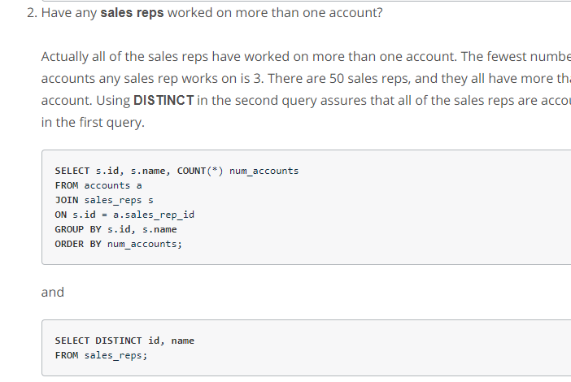
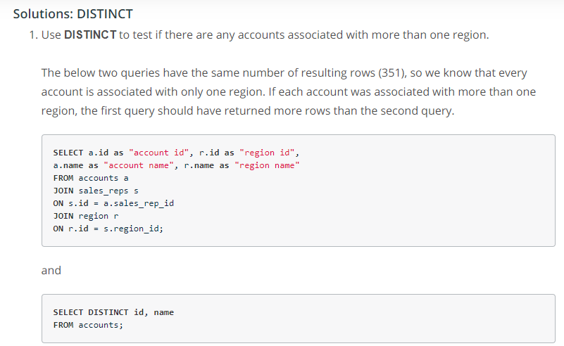
Distinct Question Solution

Slide 12
Lesson Learnt
We can always use distinct in a separate query for comparison purposes.
It is not necessary to put the distinct logic in the same query.

Slide 13
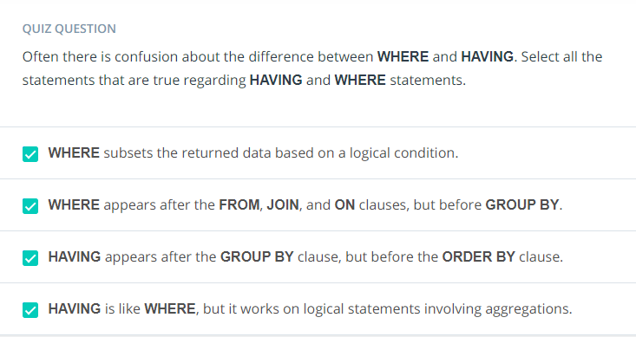
Having vs Where
Where clause cannot filter on aggregate columns, which is why we have to use having clause whenever we want to filter on the results of group by.

Slide 14
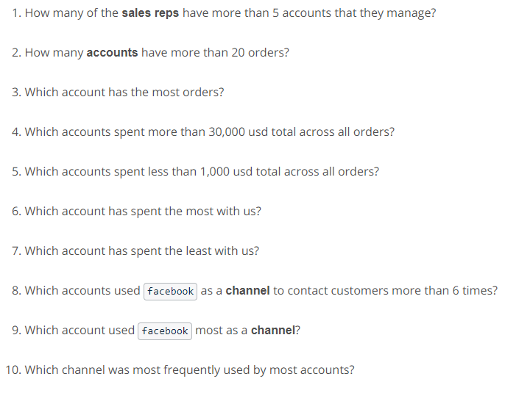
Having Questions

Slide 15
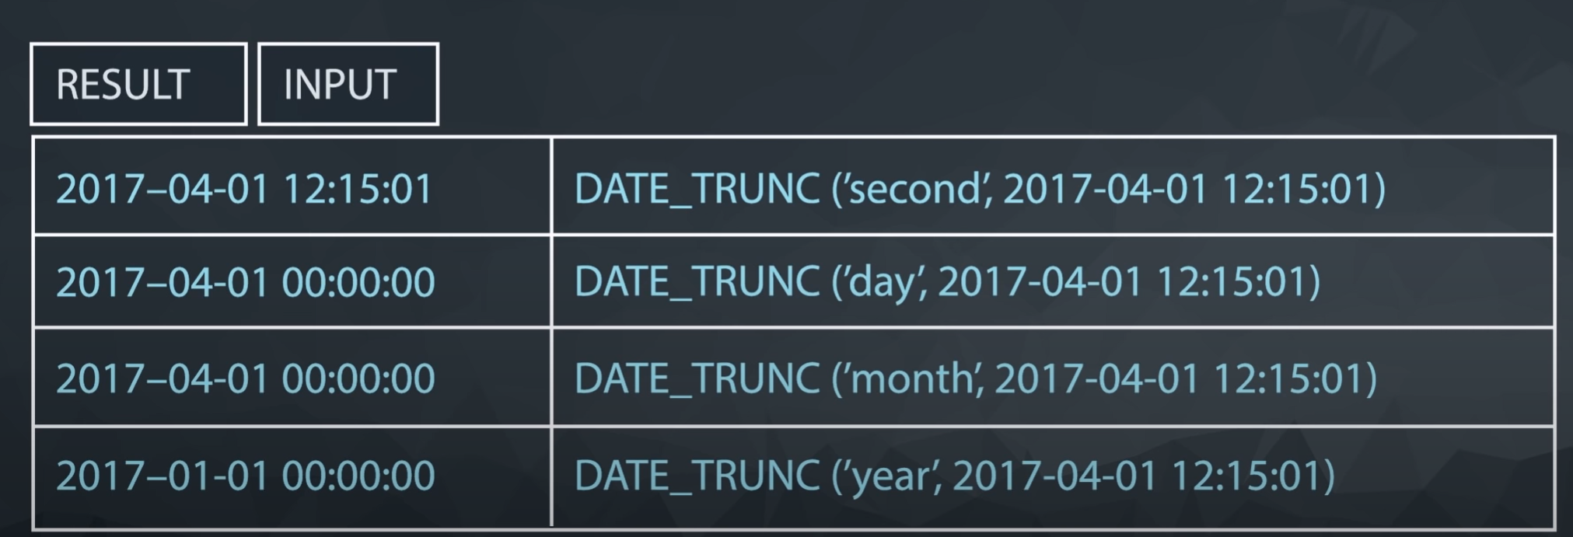
Dates, truncation
Aggregating by dates is difficult since they are unique.
Dates are stored in various formats all over the world.
Datesbases usually store in YYYY- MM- DD, easier for group by & analysis
Grouping by day needs some engineering so that we consider all hours, mins of a date.
Therefore we need some truncation.
DATE_TRUNC
In some databses, it is possible to group by year & truncate by day, don’t do this, this creates cionfusing results.

Slide 16
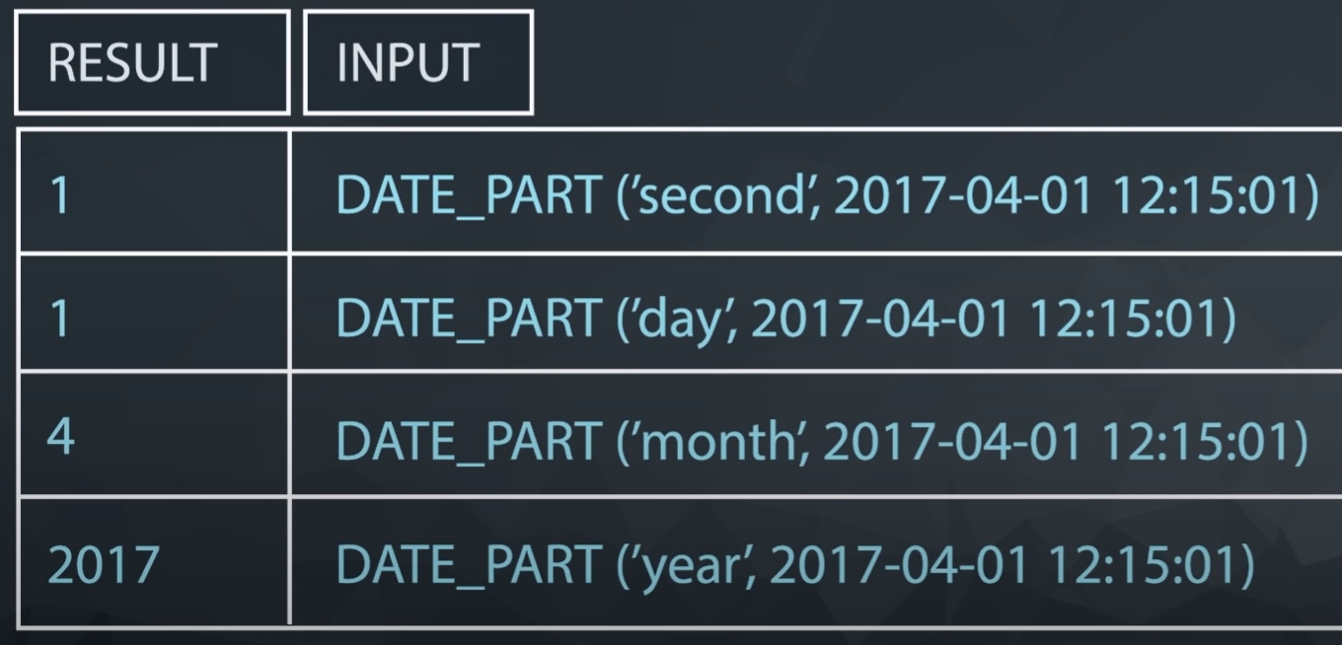
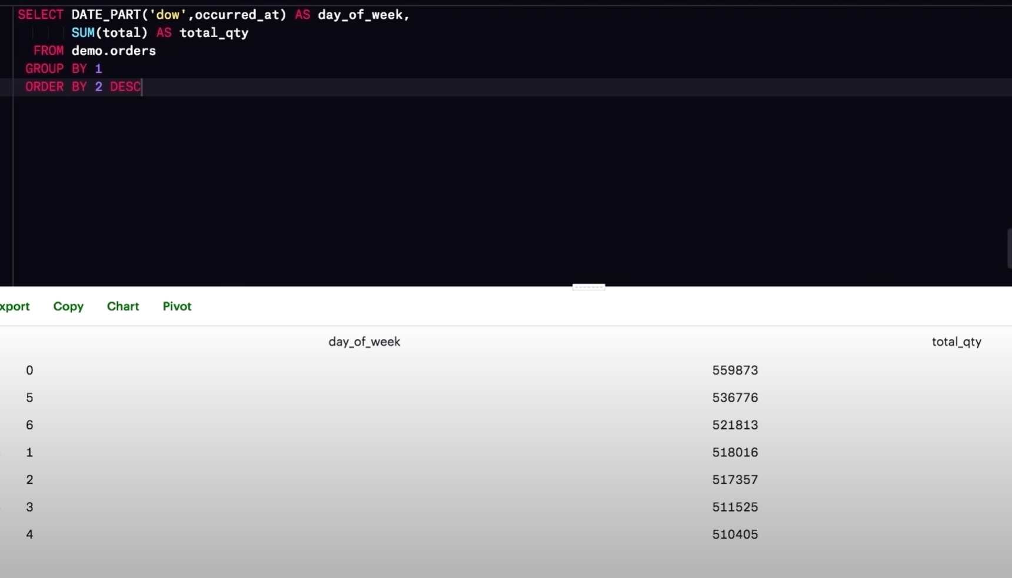
Extracting particular part of the date
For example, if we want to know which date a company see most traffic.
For this we can use date_part function
Using date part we can pull the part of the date we are interested in.
We can also use dow to pull the day of the week with 0 as Sunday.

Slide 17
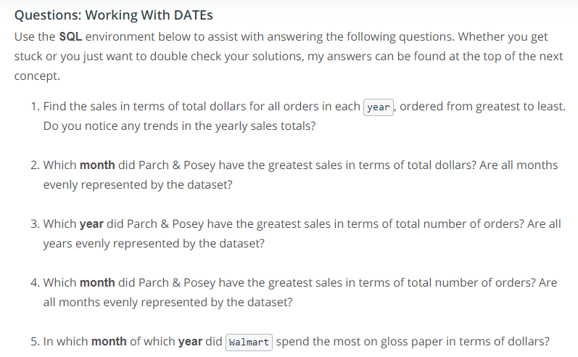
Dates Question

Slide 18
DATE_TRUNC vs Date_Part
Truncation is simply truncating the the date, decreasing or specifying the granularity or precision.
Regardless of the year, date part would provide the same month for an event that happened in April 2016 & April 2017 where as date_trunc will differentiate these dates.
Therefore, when we are doing year & month analysis it is better to use date trunc with month level granularity.

Slide 19
Case Statements – Derived Columns
The CASE statement always goes in the SELECT clause.
If then logic
CASE must include the following components: WHEN, THEN, and END. ELSE is an optional component to catch cases that didn’t meet any of the other previous CASE conditions.
Can make any conditional statement using any conditional operator (like WHERE) between WHEN and THEN. This includes stringing together multiple conditional statements using AND & OR.
Can include multiple WHEN statements, as well as an ELSE statement again, to deal with any unaddressed conditions.
Notes:
Define groups that should not overlap.

Slide 20
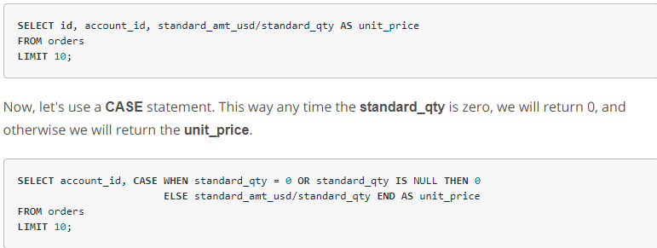
Case Statement Example
Handling division by 0

Slide 21
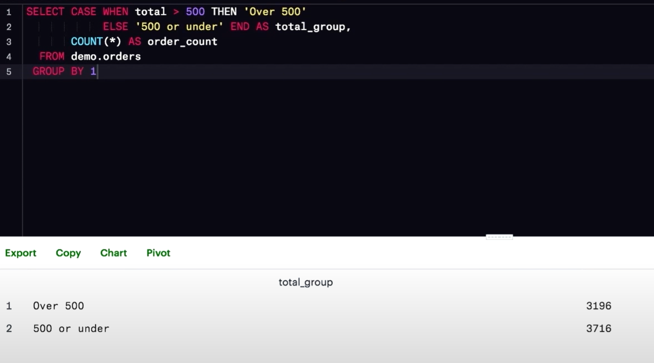
Case & Aggregation
We can create new categories & than we can aggregate based on these newly created categories.
Create a column according to our custom logic & than use group by to aggregate.
We can filter using where clause but where clause needs tobe written for each condition & we will need seprate query for filtering on each condition & grouping on that

Slide 22
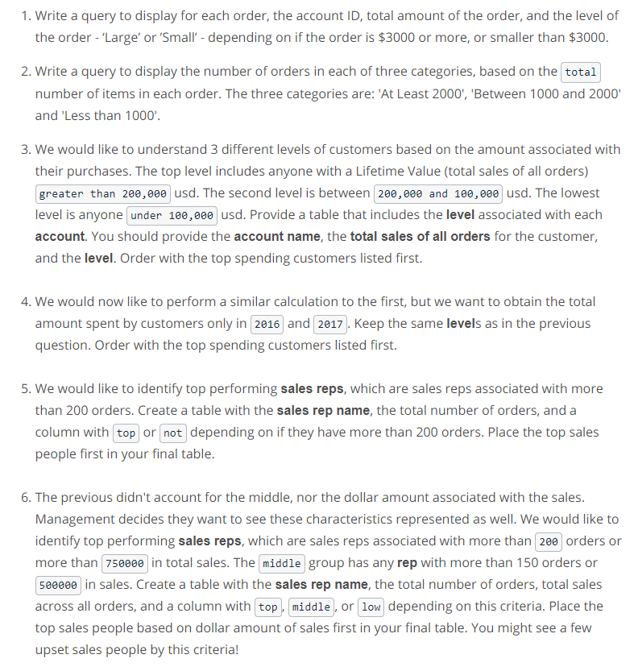
Questions : Case

